Slide 1
Risk Management
Introduction
Risk identification
Risk projection (estimation)
Risk mitigation, monitoring, and
management
(Source: Pressman, R. Software Engineering: A Practitioner’s Approach. McGraw-Hill, 2005)

Slide 2
Introduction

Slide 3
Risk
A risk is a potential problem – it might happen and it might not
Two characteristics of Risk
  Uncertainty – the risk may or may not happen, that is, there are no 100% risks (those, instead, are called constraints)
  Loss – the risk becomes a reality and unwanted consequences or losses occur

Slide 4
What Is Software Risk?
Risk is an expectation of loss, a potential problem that may or may not occur in the future.
It is generally caused due to lack of information, control or time.
A possibility of suffering from loss in software development process is called a software risk.
Loss can be anything, increase in production cost, development of poor quality software, not being able to complete the project on time.

Slide 5
Types of Software Risks
Software risk exists because the future is uncertain and there are many known and unknown things that cannot be incorporated in the project plan.
A software risk can be of two types
  Internal Risks = within the control of the project manager
  External Risks = beyond the control of project manager

Slide 6
Risk Categorization – Approach -1
Project Risks
  They threaten the project plan
  If they become real, it is likely that the project schedule will slip and that costs will increase
  Identify schedule, resource, stakeholder and requirement problems
Technical Risks
  They threaten the quality and timeliness of the software to be produced
  If they become real, implementation may become difficult or impossible
  Identify potential design, implementation, verification and maintenance problem

Slide 7
Risk Categorization – Approach -1
Business Risks
  They threaten the viability of the software to be built
  If they become real, they vulnerable for the project or the product
  Market Risk – building an excellent product or system that no one really wants
  Strategic Risk – building a product that no longer fits into the overall business strategy for the company
  Sales Risk – building a product that the sales force doesn't understand how to sell
  Management Risk – losing the support of senior management due to a change in focus or a change in people
  Budget Risk – losing budgetary or personnel commitment

Slide 8
Risk Categorization – Approach -2
Known Risks –
  Those risks that can be uncovered after evaluation of the project plan, the business and technical environment in which the project is being developed, and other reliable information sources (e.g., unrealistic delivery date)
Predictable Risks –
  Those risks that are inferred from past project experience (e.g., past turnover)
Unpredictable Risks –
  Those risks that can and do occur, but are extremely difficult to identify in advance

Slide 9
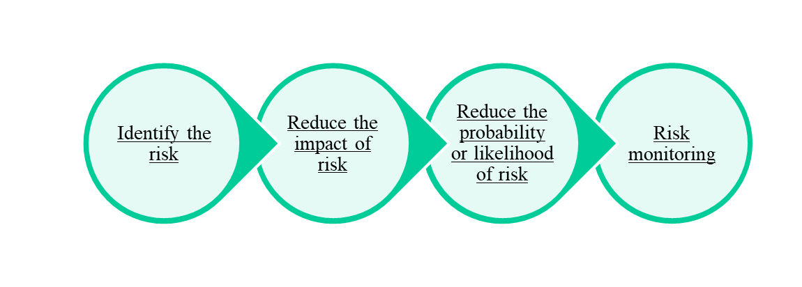
Risk Management
Risk Management is carried out to:
  Identify the risk
  Reduce the impact of risk
  Reduce the probability or likelihood of risk
  Risk monitoring

Slide 10
Steps for Risk Management
Identify possible risks; recognize what can go wrong
Analyze each risk to estimate the probability that it will occur and the impact (i.e., damage) that it will do if it does occur
Rank the risks by probability and impact
- Impact may be negligible, marginal, critical, and catastrophic
Develop a contingency plan to manage those risks having high probability and high impact

Slide 11
Risk Identification

Slide 12
Risk identification is a systematic attempt to specify threats to the project plan
By identifying known and predictable risks, the project manager takes a first step toward avoiding them when possible and controlling them when necessary
Generic Risks
  Risks that are a potential threat to every software project
Product-specific Risks
  Risks that can be identified only by those a with a clear understanding of the technology, the people, and the environment that is specific to the software that is to be built
  This requires examination of the project plan and the statement of scope
  "What special characteristics of this product may threaten our project plan?"

Slide 13
Risk Item Checklist
Used as one way to identify risks
Focuses on known and predictable risks in specific subcategories (see next slide)
Can be organized in several ways
  A list of characteristics relevant to each risk subcategory
  Questionnaire that leads to an estimate on the impact of each risk
  A list containing a set of risk component and drivers and their probability of occurrence

Slide 14
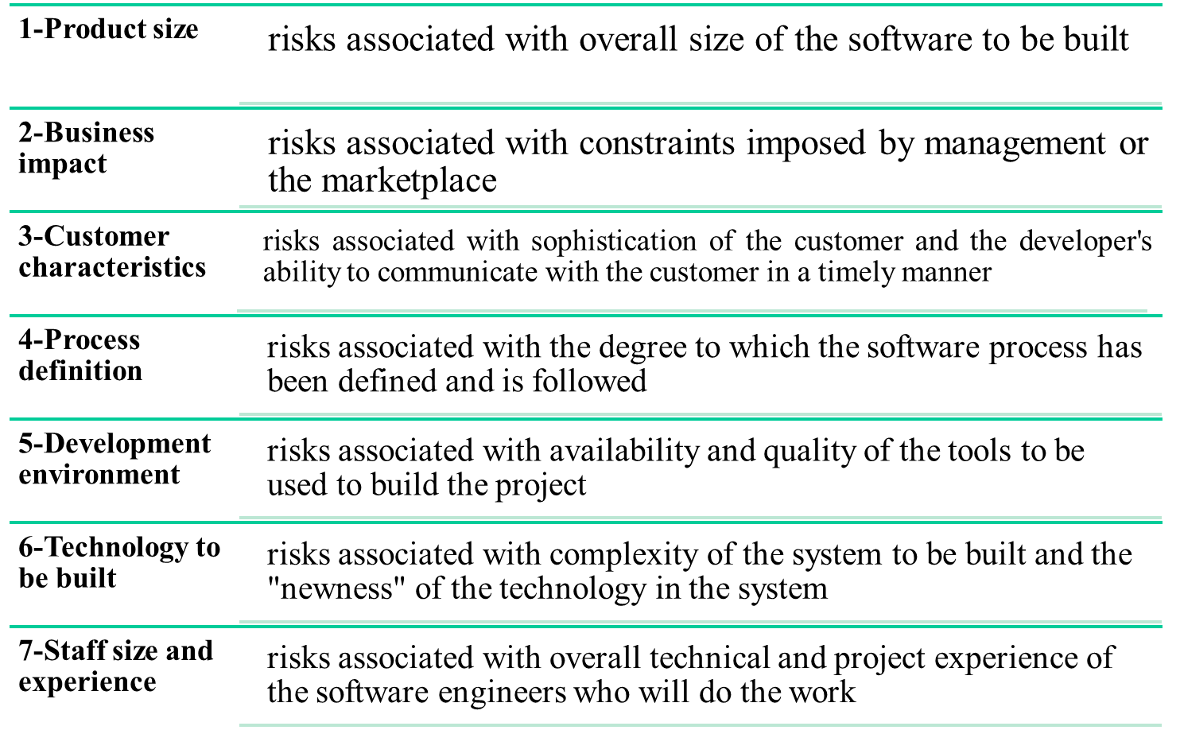
Known and Predictable Risk Categories

Slide 15
Questionnaire on Project Risk
(Questions are ordered by their relative importance to project success)
Have top software and customer managers formally committed to support the project?
Are end-users enthusiastically committed to the project and the system/product to be built?
Are requirements fully understood by the software engineering team and its customers?
Have customers been involved fully in the definition of requirements?
Do end-users have realistic expectations?
Is the project scope stable?
(More on next slide)

Slide 16
Questionnaire on Project Risk (continued)
Does the software engineering team have the right mix of skills?
Are project requirements stable?
Does the project team have experience with the technology to be implemented?
Is the number of people on the project team adequate to do the job?
Do all customer/user constituencies agree on the importance of the project and on the requirements for the system/product to be built?

Slide 17
Risk Components and Drivers
The project manager identifies the risk drivers that affect the following risk components
  Performance Risk - the degree of uncertainty that the product will meet its requirements and be fit for its intended use
  Cost Risk - the degree of uncertainty that the project budget will be maintained
  Support Risk - the degree of uncertainty that the resultant software will be easy to correct, adapt, and enhance
  Schedule Risk - the degree of uncertainty that the project schedule will be maintained and that the product will be delivered on time
The impact of each risk driver on the risk component is divided into one of four impact levels
  Negligible, marginal, critical, and catastrophic

Slide 18
Risk Projection (Estimation)

Slide 19
Background
Risk projection (or estimation) attempts to rate each risk in two ways
  The probability that the risk is real
  The consequence of the problems associated with the risk, should it occur
The project planner, managers, and technical staff perform four risk projection steps (see next slide)
The intent of these steps is to consider risks in a manner that leads to prioritization
By prioritizing risks, the software team can allocate limited resources where they will have the most impact

Slide 20
Risk Projection / Estimation Steps
Establish a scale that reflects the perceived likelihood of a risk (e.g., 1-low, 10-high)
Describe the consequences of the risk
Estimate the impact of the risk on the project and product
Note the overall accuracy of the risk projection so that there will be no misunderstandings

Slide 21
Contents of a Risk Table
A risk table provides a simple technique for risk projection
It consists of five columns
  Risk Summary – short description of the risk
  Risk Category – one of seven risk categories (slide 12)
  Probability – estimation of risk occurrence based on group input
  Impact – (1) catastrophic (2) critical (3) marginal (4) negligible
  RMMM – Pointer to a paragraph in the Risk Mitigation, Monitoring, and Management Plan
Risk Summary | Risk Category | Probability | Impact (1-4) | RMMM

Slide 22
Developing a Risk Table
List all risks in the first column (by way of the help of the risk item checklists)
Mark the category of each risk
Estimate the probability of each risk occurring
Assess the impact of each risk based on an averaging of the four risk components to determine an overall impact value (See next slide)
Sort the rows by probability and impact in descending order
Draw a horizontal cutoff line in the table that indicates the risks that will be given further attention

Slide 23
Assessing Risk Impact
Three factors affect the consequences that are likely if a risk does occur
  Its Nature – This indicates the problems that are likely if the risk occurs
  Its Scope – This combines the severity of the risk (how serious was it) with its overall distribution (how much was affected)
  Its Timing – This considers when and for how long the impact will be felt
The overall Risk Exposure formula is
RE = P x C
  P = the probability of occurrence for a risk
  C = the cost to the project should the risk actually occur
Example
  P = 80% probability that 18 of 60 software components will have to be developed
  C = Total cost of developing 18 components is $25,000
  RE = 0.80 x $25,000 = $20,000

Slide 24
Risk exposure can be computed for each risk in the risk table
The total risk exposure for all risks (above the cutoff in the risk table) can provide a means for adjusting the final cost estimate for a project.
It can also be used to predict the probable increase in staff resources required at various points during the project schedule

Slide 25
Risk Mitigation, Monitoring and Management (RMMM)

Slide 26
Background
An effective strategy for dealing with risk must consider three issues
(Note: these are not mutually exclusive)
  Risk Mitigation (i.e., avoidance)
  Risk Monitoring
  Risk Management and contingency planning
(More on next slide)

Slide 27
Risk Mitigation =
  Risk Mitigation is the process of planning and developing methods and options to reduce threats
  Risk mitigation is the practice of reducing the impact of potential risks by developing a plan to manage, eliminate, or limit setbacks as much as possible
  4 Types –
    Avoidance
    Reduction
    Transference
    Acceptance
(More on next slide)

Slide 28
  Avoidance =
    To avoid the risk from occurring
    Require compromising other resources or strategies
    Ex:
      You may face a risk where you won’t be able to complete a task for an important project due to a lack of specialists. To avoid this risk, you could hire multiple specialists, just in case one got sick or wasn’t available.
    Here hiring more resources would take a bigger slice out of the budget, so assessing how much you can compromise is an important step in this strategy.

Slide 29
  Reduction =
    To reduce the likelihood of a risk happening or the impact should it occur.
    Ex:
      Suppose your budget is tight and there’s a risk you can’t complete a particular project due to a lack of funds.
      You can reduce the likelihood of that risk occurring by proactively managing the costs within the budget. In this scenario, you could choose a cheaper option for raw materials or reduce the project scope so it can be completed within budget

Slide 30
  Transference =
    Passing the risk consequence to a third party.
    There might also be risk transference written into contracts with suppliers, outsourcing partners, or contractors.

Slide 31
  Acceptance =
    Accepting the risk as it stands
    The probability of the risk occurring is extremely small, or the negative impact is minor
    With risk acceptance, it’s vital to monitor the risk carefully for any changes to impact or likelihood of occurrence

Slide 32
Example-1: Risk of high staff turnover :
Meet with current staff to determine causes for turnover (e.g., poor working conditions, low pay, competitive job market)
Mitigate those causes that are under our control before the project starts
Once the project commences, assume turnover will occur and develop techniques to ensure continuity when people leave
Organize project teams so that information about each development activity is widely dispersed
Define documentation standards and establish mechanisms to ensure that documents are developed in a timely manner
Conduct peer reviews of all work (so that more than one person is "up to speed")
Assign a backup staff member for every critical technologist

Slide 33
Example-2: Insurance:
A solution to mitigate the financial burden of a business disruption, loss, or damage to a structure or machinery is to get insurance. Insurance firms present various insurance products offering coverage for a variety of damages.

Slide 34
Example-3: Diversification:
Portfolio diversification is an example of a risk mitigation strategy utilized to reduce the risk when investing. Diversification includes combining a wide range of investments into a portfolio. Since investments are not similar, they react differently to movements in the market as a whole. Altogether the method focuses on balancing the risk and reward.

Slide 35
Risk Monitoring =
  During risk monitoring, the project manager monitors factors that may provide an indication of whether a risk is becoming more or less likely
Risk Monitoring =
  Risk management and contingency planning assume that mitigation efforts have failed and that the risk has become a reality
(More on next slide)

Slide 36
The RMMM Plan
The RMMM plan may be a part of the software development plan or may be a separate document
Once RMMM has been documented and the project has begun, the risk mitigation, and monitoring steps begin
  Risk mitigation is a problem avoidance activity
  Risk monitoring is a project tracking activity
Risk monitoring has three objectives
  To assess whether predicted risks do, in fact, occur
  To ensure that risk aversion steps defined for the risk are being properly applied
  To collect information that can be used for future risk analysis
The findings from risk monitoring may allow the project manager to ascertain what risks caused which problems throughout the project
Notes:
(Paragraph 5.19.1)

Slide 37
Risk Mitigation Steps –
  Identifying the risk.
  Getting rid of the causes that lead to the production of risk.
  Controlling the relevant documents regularly.
  Conducting timely reviews to accelerate the process.
Risk Monitoring Steps –
  To see if the risks that were anticipated actually happen.
  To verify that the risk aversion steps defined for risk are adequately implemented.
  To gather information for future risk assessments.
  To determine which risks generate which problems throughout the project.

Slide 38
The RMMM Plan
Risk-1 : Lack of Development Experience
Risk-2 : Changes in Requirements
Risk-3 : Late Delivery
Risk-4 : Computer Crash
Risk-5 : Poor Quality Documentation
Risk-6 : People Risk
Risk-7 : Technology Risk
Notes:
(Paragraph 5.19.1)

